Slide 1
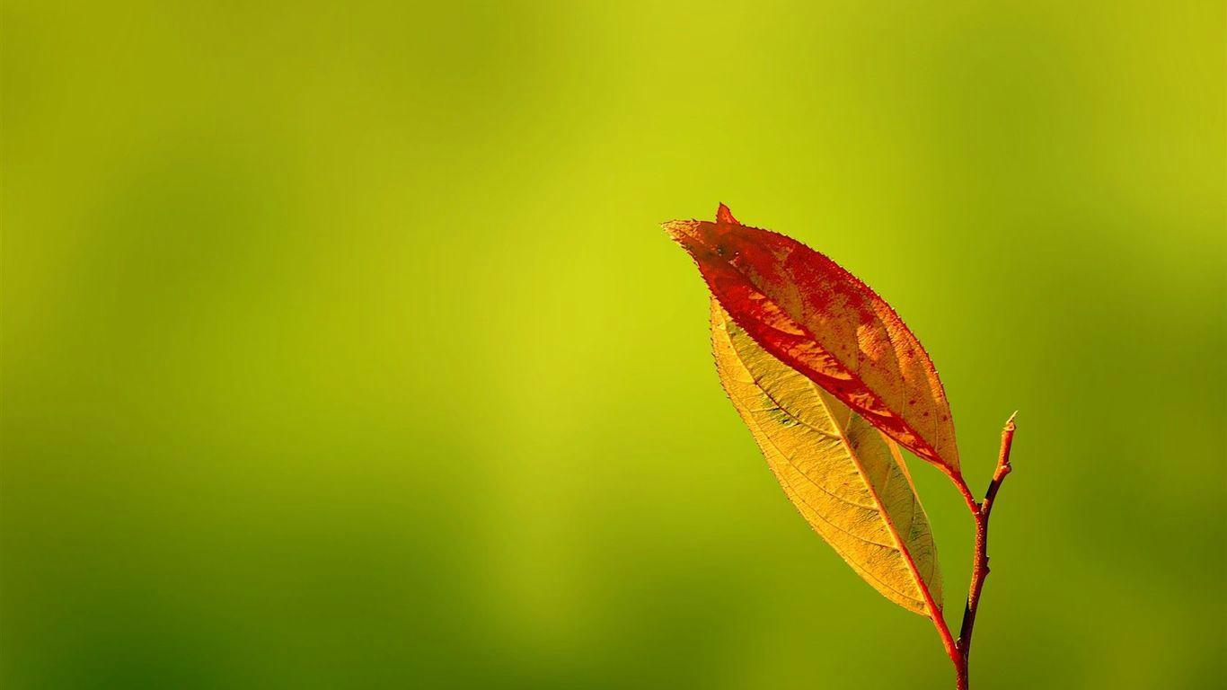
我奇妙的救主
My Wonderful Lord

Slide 2
1/4
我心深處有平安非人所能知，
我有喜樂非所能給，
自我將我身心完全奉獻與主，
獻給奇妙奇妙救主。
I have found a deep peace
that I never had known And a joy this world could not afford Since I yielded control of my body and soul To my wonderful, wonderful Lord.

Slide 3
我奇妙救主，我奇妙救主，
在天上眾天使在歌唱讚美！
我俯伏敬拜，我救贖恩主，
我奇妙的奇妙救主。
My wonderful Lord, my wonderful Lord By angels and seraphs in Heaven adored! I know Thou art mine, my Savior divine My wonderful, wonderful Lord.

Slide 4
2/4
我願將我的生命交托主管理，
我心志完全歸向救主，
惟願救主旨意，成全在我身上，
我奇妙的奇妙救主。
I desire that my life
shall be ordered by Thee That my will be in perfect accord With Thine own sov'reign will Thy desires to fulfill

Slide 5
我奇妙救主，我奇妙救主，
在天上眾天使在歌唱讚美！
我俯伏敬拜，我救贖恩主，
我奇妙的奇妙救主。
My wonderful Lord, my wonderful Lord By angels and seraphs in Heaven adored! I know Thou art mine, my Savior divine My wonderful, wonderful Lord.

Slide 6
3/4
我願將所有才幹奉獻祢腳前，
蒙祢悅納即是我賞賜，
所有或多或少，願完全獻上，
獻給奇妙奇妙救主。
All the talents I have I have laid at Thy Feet Thy approval shall be my reward. Be my store great or small I surrender it all To my wonderful, wonderful Lord.

Slide 7
我奇妙救主，我奇妙救主，
在天上眾天使在歌唱讚美！
我俯伏敬拜，我救贖恩主，
我奇妙的奇妙救主。
My wonderful Lord, my wonderful Lord By angels and seraphs in Heaven adored! I know Thou art mine, my Savior divine My wonderful, wonderful Lord.

Slide 8
4/4
世上一切的美好中祢最美好，
祢是全能者生命之道，
從亙古到永久，配得榮耀讚美，
我奇妙的奇妙救主。
Thou art fairer to me than the fairest of earth Thou omnipotent, life-giving Word O Thou Ancient of Days, Thou art worthy all praise, My wonderful, wonderful Lord.

Slide 9
我奇妙救主，我奇妙救主，
在天上眾天使在歌唱讚美！
我俯伏敬拜，我救贖恩主，
我奇妙的奇妙救主。
My wonderful Lord, my wonderful Lord By angels and seraphs in Heaven adored! I know Thou art mine, my Savior divine My wonderful, wonderful Lord.

